Slide 1

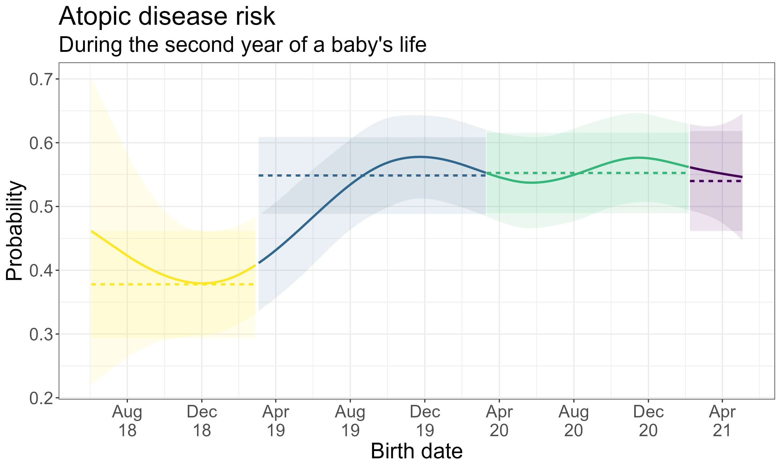
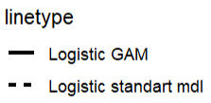
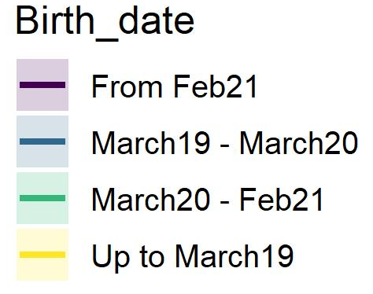
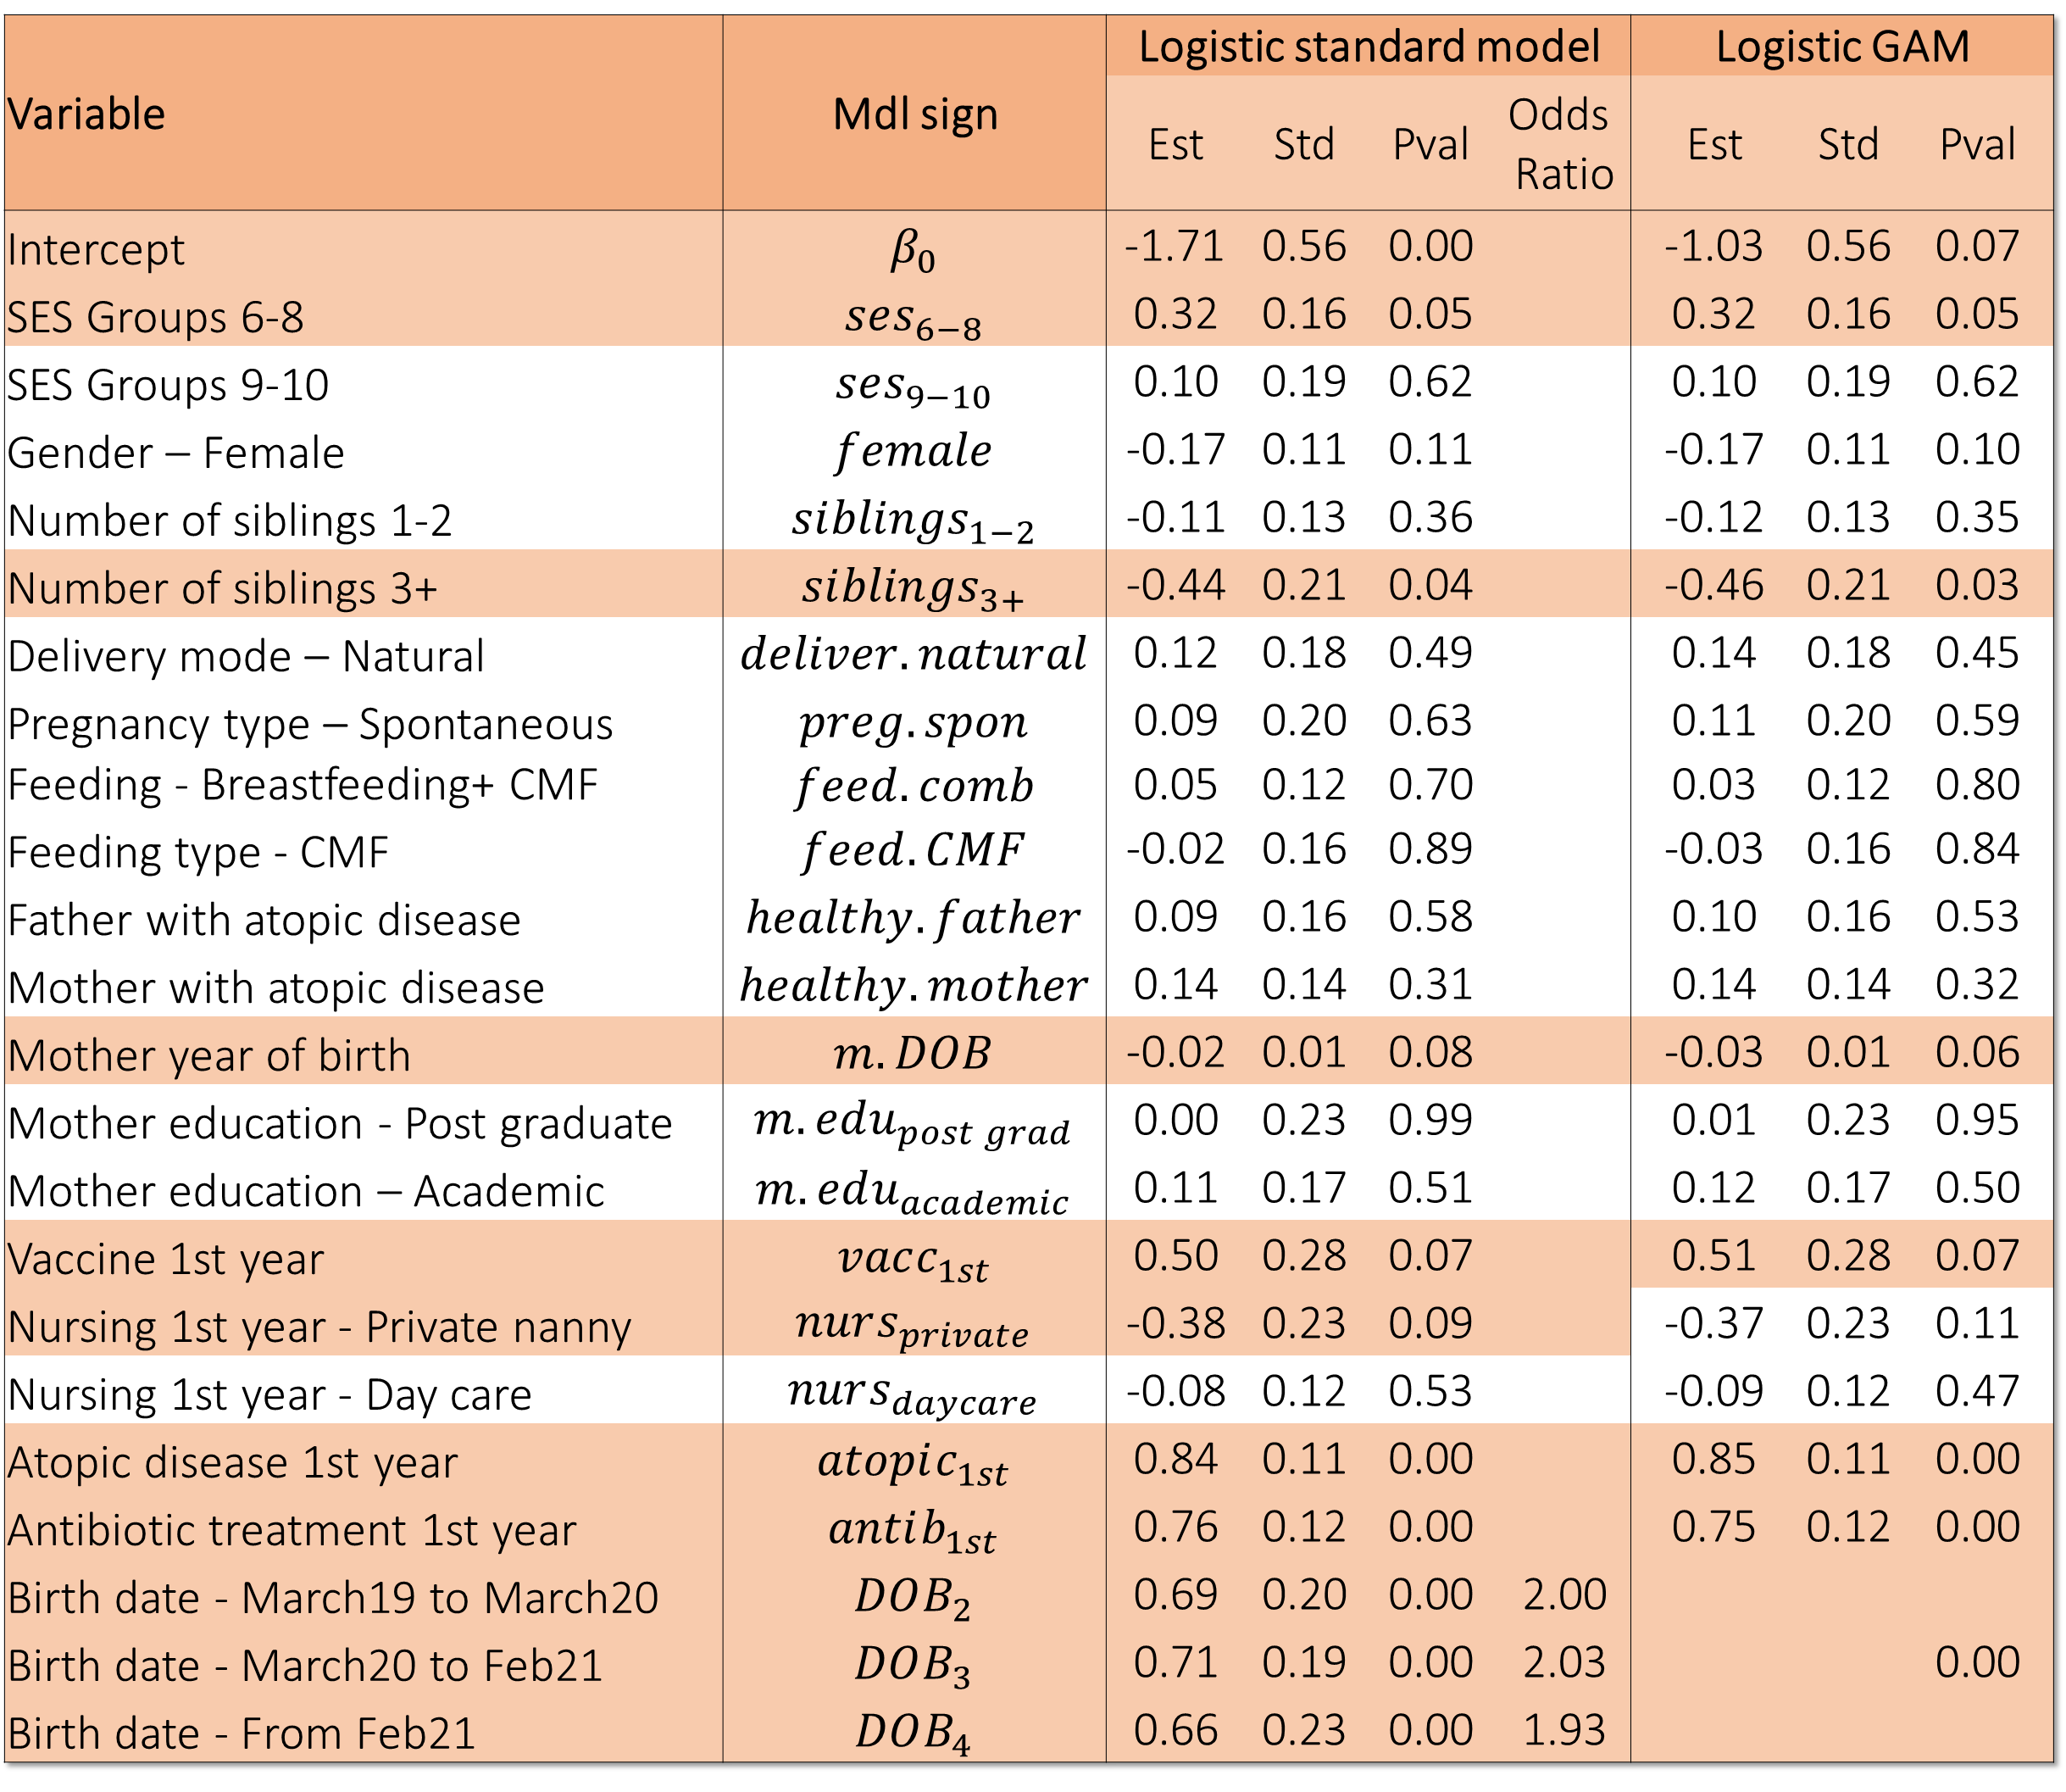
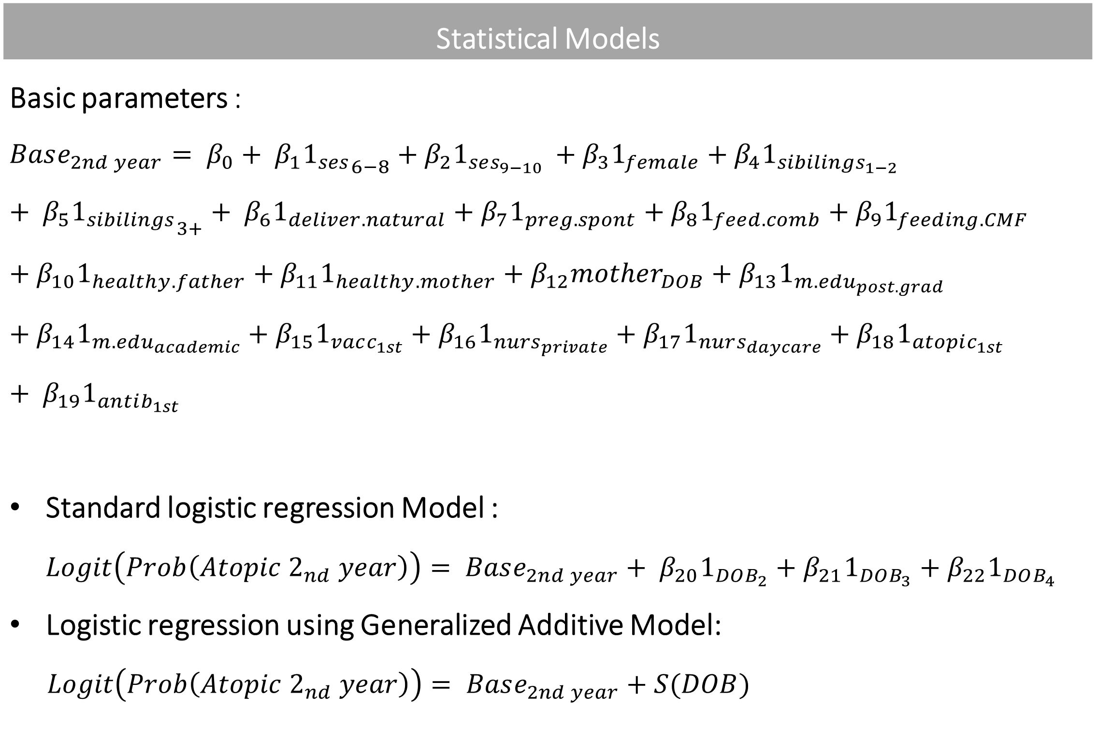
The Golden opportunity Examining the effect of hygiene theory on atopic diseases in newborns
Shahar Shalom, Eden Anavim, Merav Pervil | Faculty Instructor: Prof. Micha Mandel
Counselee: Prof. Idit Lachover-Roth, Allergy & Clinical Immunology Unit, Meir Medical Center, Israel
Background and previous studies
Background: Atopy is a type of allergy. Two main causes are genetics and hygiene- lack of exposure to antigens in childhood. The pandemic created a special situation for investigation the last. Previous studies: According to Israeli Ministry of Health, COVID19 caused decrease in respiratory infections following the restrictions. It may explain research findings of low incidence of respiratory infections in babies born early in the pandemic.
Results
Results of the Second-year - Logistic standard regression Vs. Logistic GAM: Probability of a typical baby getting an Atopic disease (2nd Y) depending on birth date:
Variable | Mdl sign | Logistic standard model |  |  |  | Logistic GAM
 |  | Est | Std | Pval | Odds Ratio | Est | Std | Pval
Intercept | $$β_{0}$$ | -1.71 | 0.56 | 0.00 |  | -1.03 | 0.56 | 0.07
SES Groups 6-8 | $$ses_{6−8}$$ | 0.32 | 0.16 | 0.05 |  | 0.32 | 0.16 | 0.05
SES Groups 9-10 | $$ses_{9−10}$$ | 0.10 | 0.19 | 0.62 |  | 0.10 | 0.19 | 0.62
Gender – Female | $$female$$ | -0.17 | 0.11 | 0.11 |  | -0.17 | 0.11 | 0.10
Number of siblings 1-2 | $$si{blings}_{1−2}$$ | -0.11 | 0.13 | 0.36 |  | -0.12 | 0.13 | 0.35
Number of siblings 3+ | $$si{blings}_{3+}$$ | -0.44 | 0.21 | 0.04 |  | -0.46 | 0.21 | 0.03
Delivery mode – Natural | $$deliver.natural$$ | 0.12 | 0.18 | 0.49 |  | 0.14 | 0.18 | 0.45
Pregnancy type – Spontaneous | $$preg.spon$$ | 0.09 | 0.20 | 0.63 |  | 0.11 | 0.20 | 0.59
Feeding - Breastfeeding+ CMF | $$feed.comb$$ | 0.05 | 0.12 | 0.70 |  | 0.03 | 0.12 | 0.80
Feeding type - CMF | $$feed.CMF$$ | -0.02 | 0.16 | 0.89 |  | -0.03 | 0.16 | 0.84
Father with atopic disease | $$healthy.father$$ | 0.09 | 0.16 | 0.58 |  | 0.10 | 0.16 | 0.53
Mother with atopic disease | $$healthy.mother$$ | 0.14 | 0.14 | 0.31 |  | 0.14 | 0.14 | 0.32
Mother year of birth | $$m.DOB$$ | -0.02 | 0.01 | 0.08 |  | -0.03 | 0.01 | 0.06
Mother education - Post graduate | $$m.edu_{post grad}$$ | 0.00 | 0.23 | 0.99 |  | 0.01 | 0.23 | 0.95
Mother education – Academic | $$m.edu_{academic}$$ | 0.11 | 0.17 | 0.51 |  | 0.12 | 0.17 | 0.50
Vaccine 1st year | $$vacc_{1st}$$ | 0.50 | 0.28 | 0.07 |  | 0.51 | 0.28 | 0.07
Nursing 1st year - Private nanny | $$nurs_{private}$$ | -0.38 | 0.23 | 0.09 |  | -0.37 | 0.23 | 0.11
Nursing 1st year - Day care | $$nurs_{daycare}$$ | -0.08 | 0.12 | 0.53 |  | -0.09 | 0.12 | 0.47
Atopic disease 1st year | $$atopic_{1st}$$ | 0.84 | 0.11 | 0.00 |  | 0.85 | 0.11 | 0.00
Antibiotic treatment 1st year | $$antib_{1st}$$ | 0.76 | 0.12 | 0.00 |  | 0.75 | 0.12 | 0.00
Birth date - March19 to March20 | $$DOB_{2}$$ | 0.69 | 0.20 | 0.00 | 2.00 |  |  | 0.00
Birth date - March20 to Feb21 | $$DOB_{3}$$ | 0.71 | 0.19 | 0.00 | 2.03
Birth date - From Feb21 | $$DOB_{4}$$ | 0.66 | 0.23 | 0.00 | 1.93
Research Objective
Examine the impact of a highly hygienic environment during, before and after COVID19 on Atopic diseases among babies.
Data and its collection
Data was collected starting from November 2018. Experiment participants: Hebrew-speaking across all sectors, near the date of birth for babies who were born at week 36 or later with a normal birth weight and without any birth defects. At predetermined intervals, parents were sent questionnaires. Characteristics of the babies, their families and environment were collected. Development of atopic diseases among babies was examined. Atopic disease = food allergies, atopic dermatitis or hyperreactive airway. The babies were divided into 4 groups according to birth date and main landmarks during the pandemic
Group | Birth | 1Y Sickness percent | 2Y Sickness percent
1 | Up to March19 | 520. | 0.36
2 | March19 to March20 | 0.50 | 0.43
3 | March20 to Feb21 | 0.55 | 0.49
4 | From Feb21 | 0.70 | 0.51
Statistical Models
Basic parameters : $Base_{2nd year}= β_{0}+ β_{1}{1_{ses}}_{6−8}+β_{2}1_{ses_{9−10} }+β_{3}1_{female}+β_{4}1_{sibilings_{1−2}}+ β_{5}{1_{sibilings}}_{3+}+ β_{6}1_{deliver.natural}+β_{7}1_{preg.spont}+β_{8}1_{feed.comb}+β_{9}1_{feeding.CMF}+β_{10}1_{healthy.father}+β_{11}1_{healthy.mother}+β_{12}mother_{DOB}+β_{13}1_{m.edu_{post.grad}}+β_{14}1_{m.edu_{academic}}+β_{15}1_{vacc_{1st}}+β_{16}1_{{nurs}_{private}}+β_{17}1_{nurs_{daycare}}+β_{18}1_{atopic_{1st}}+ β_{19}1_{antib_{1st}}$ Standard logistic regression Model : $Logit\left(Prob\left(Atopic 2_{nd} year\right)\right)= Base_{2nd year}+ {β_{20}1}_{DOB_{2}}+β_{21}1_{DOB_{3}}+β_{22}1_{DOB_{4}}$ Logistic regression using Generalized Additive Model: $$Logit\left(Prob\left(Atopic 2_{nd} year\right)\right)= Base_{2nd year}+S(DOB)$$
Conclusions
In the Logistic model, birth date variables are significant. The smoothed estimator in Logistic GAM is significant as well. For babies born during the Covid19 period, the risk of getting an atopic disease in the second year of life was increased.
According to the logistic model, the chance of a baby born after the start of covid (when hygiene increased) to get a atopia in the second year increased approximately 2 times in all age groups. In the GAM model it is possible to identify an increase of about 37% in the chance of a baby born after the start of the corona virus to get a atopia in the second year.

